Slide 1

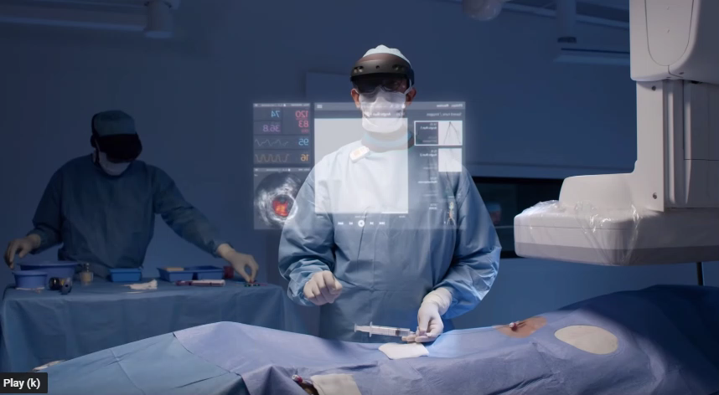
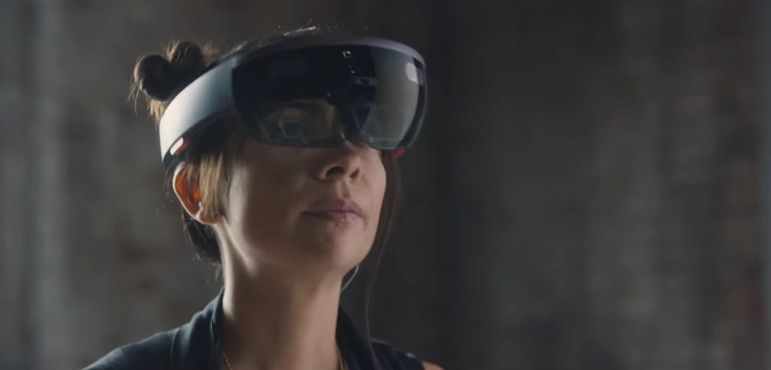
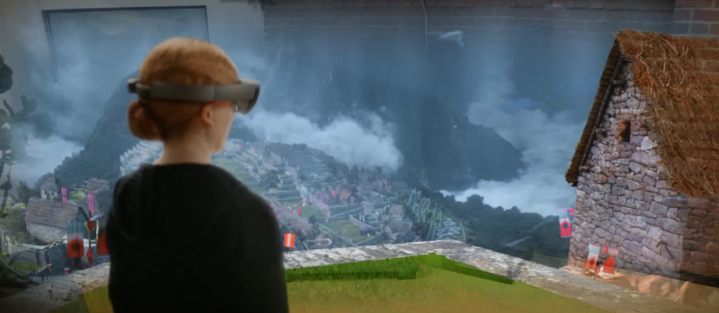
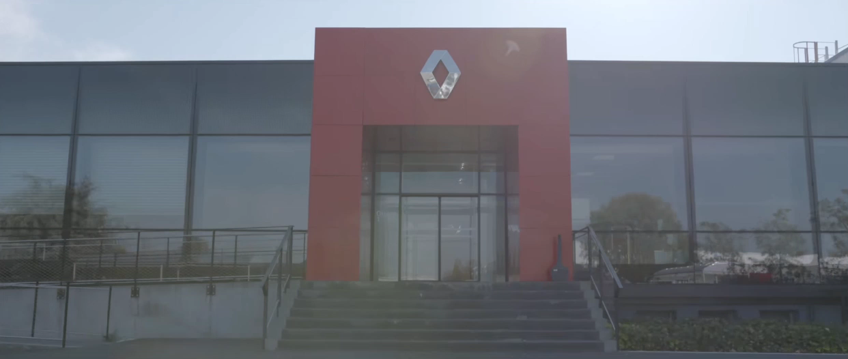
APPLICATIONS OF MIXED REALITY
HEALTH CARE DESIGNING AND ENTERPRISES
SIMULATION BASED LEARNING MANUFACTURING AND AUTOMOBILES

Slide 2

REFERENCES
www.wikipedia.com
www.rubygarage.org
www.quora.com
www.medium.co.uk
www.youtube.com/vrworld
www.simplicable.com
www.lifewire.com

Slide 3
THANK YOU , ANY QUERIES?

